Slide 1
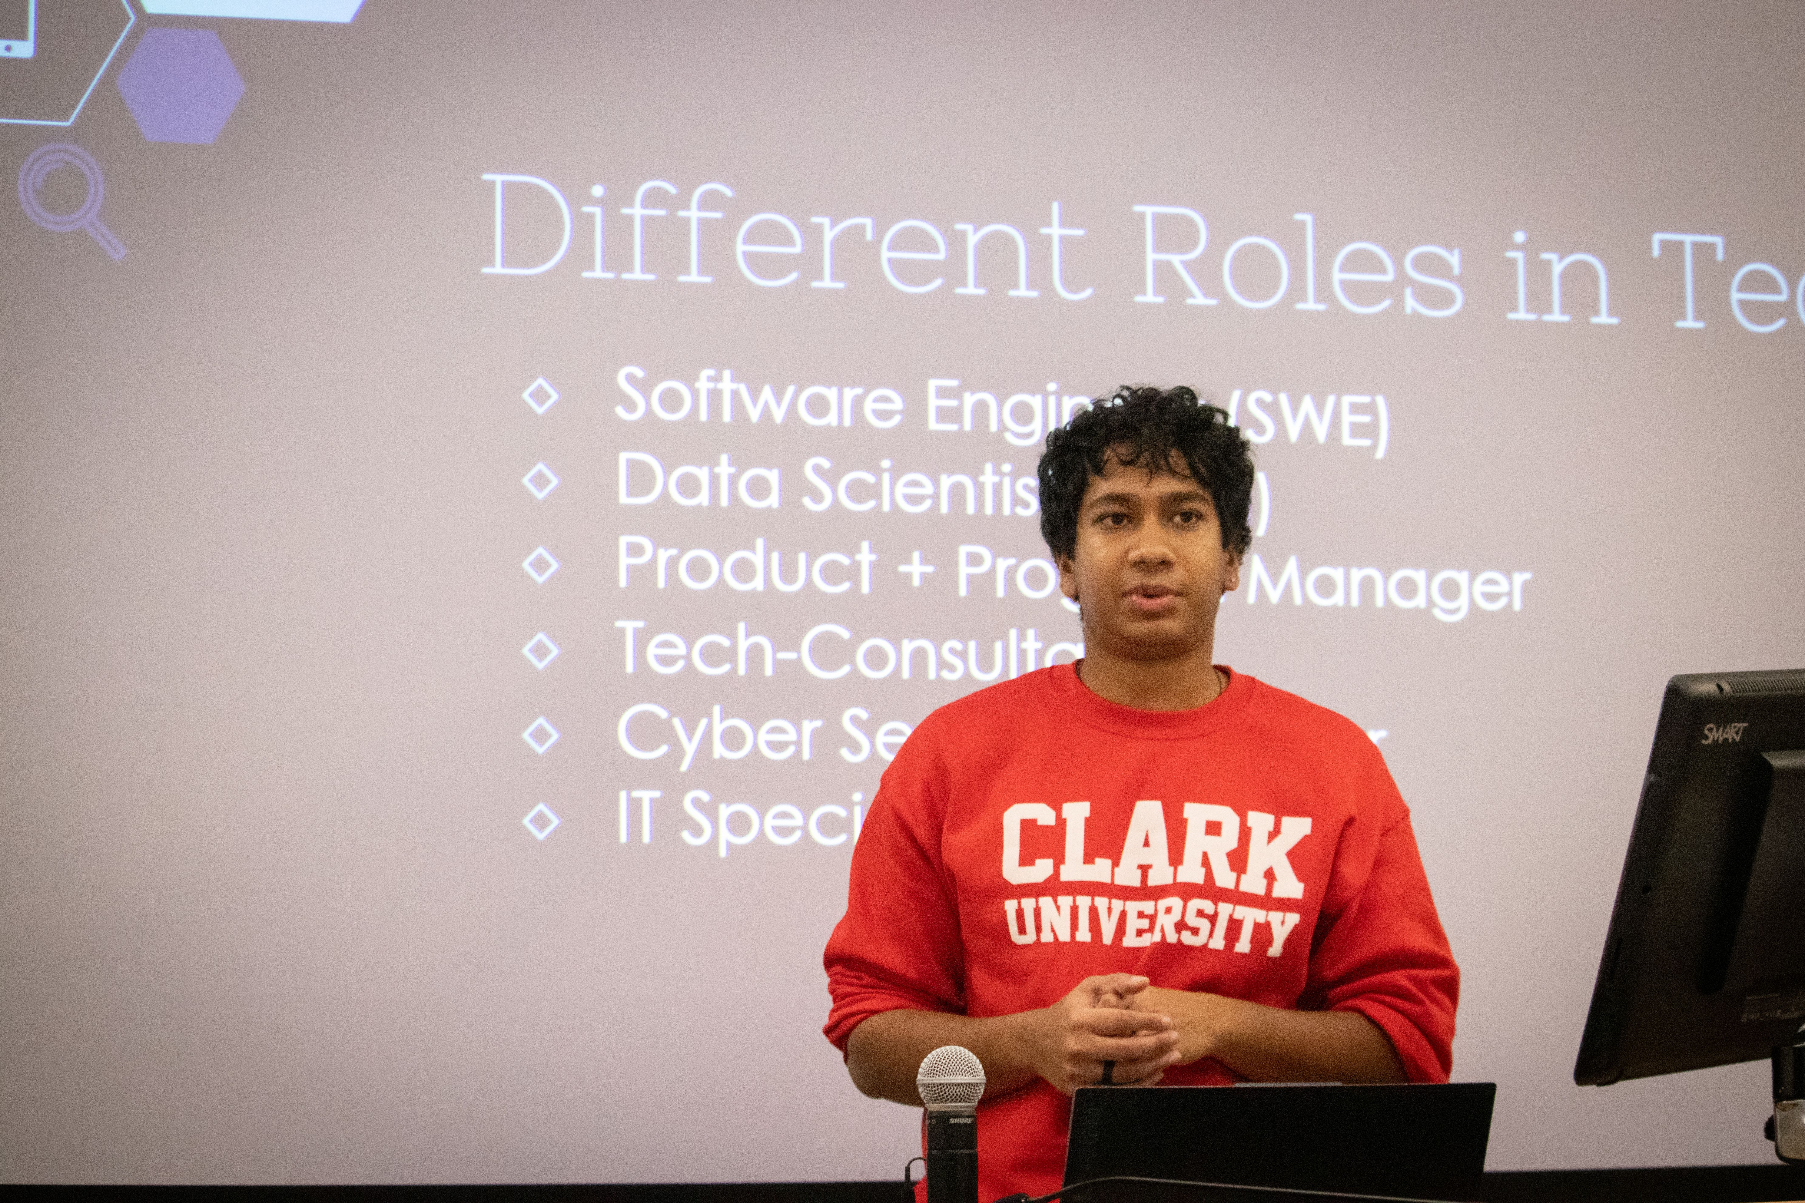
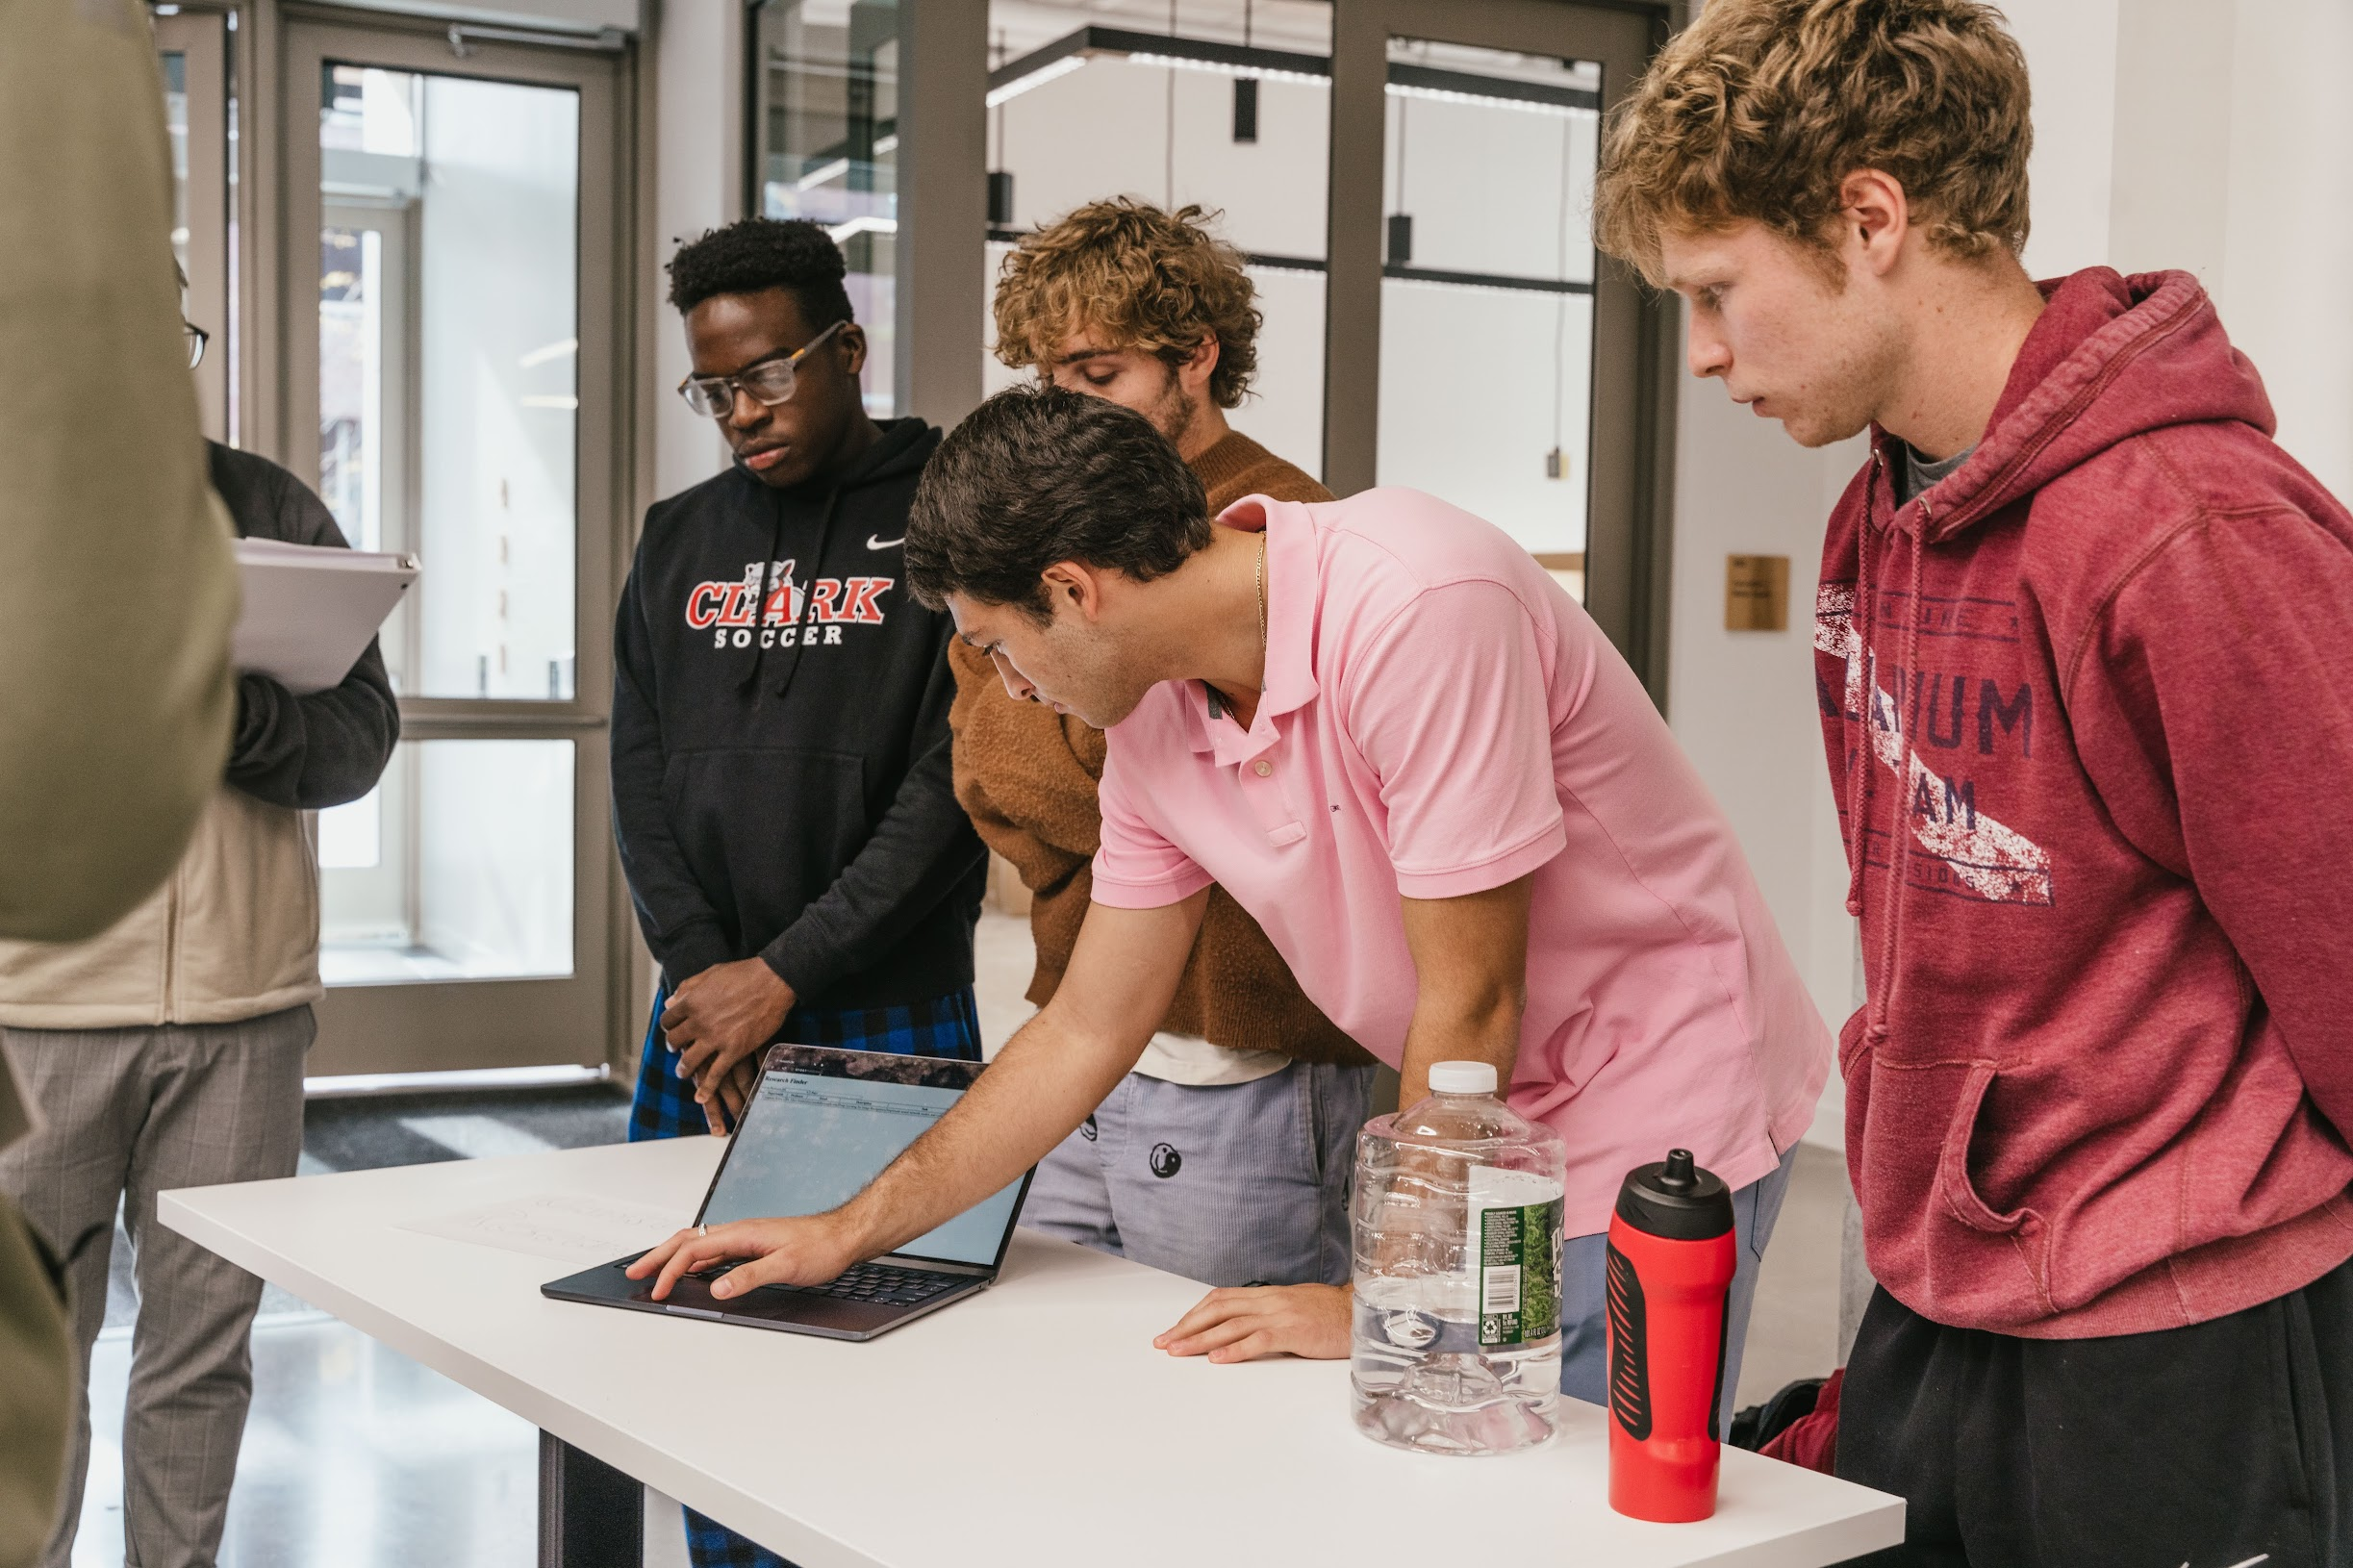
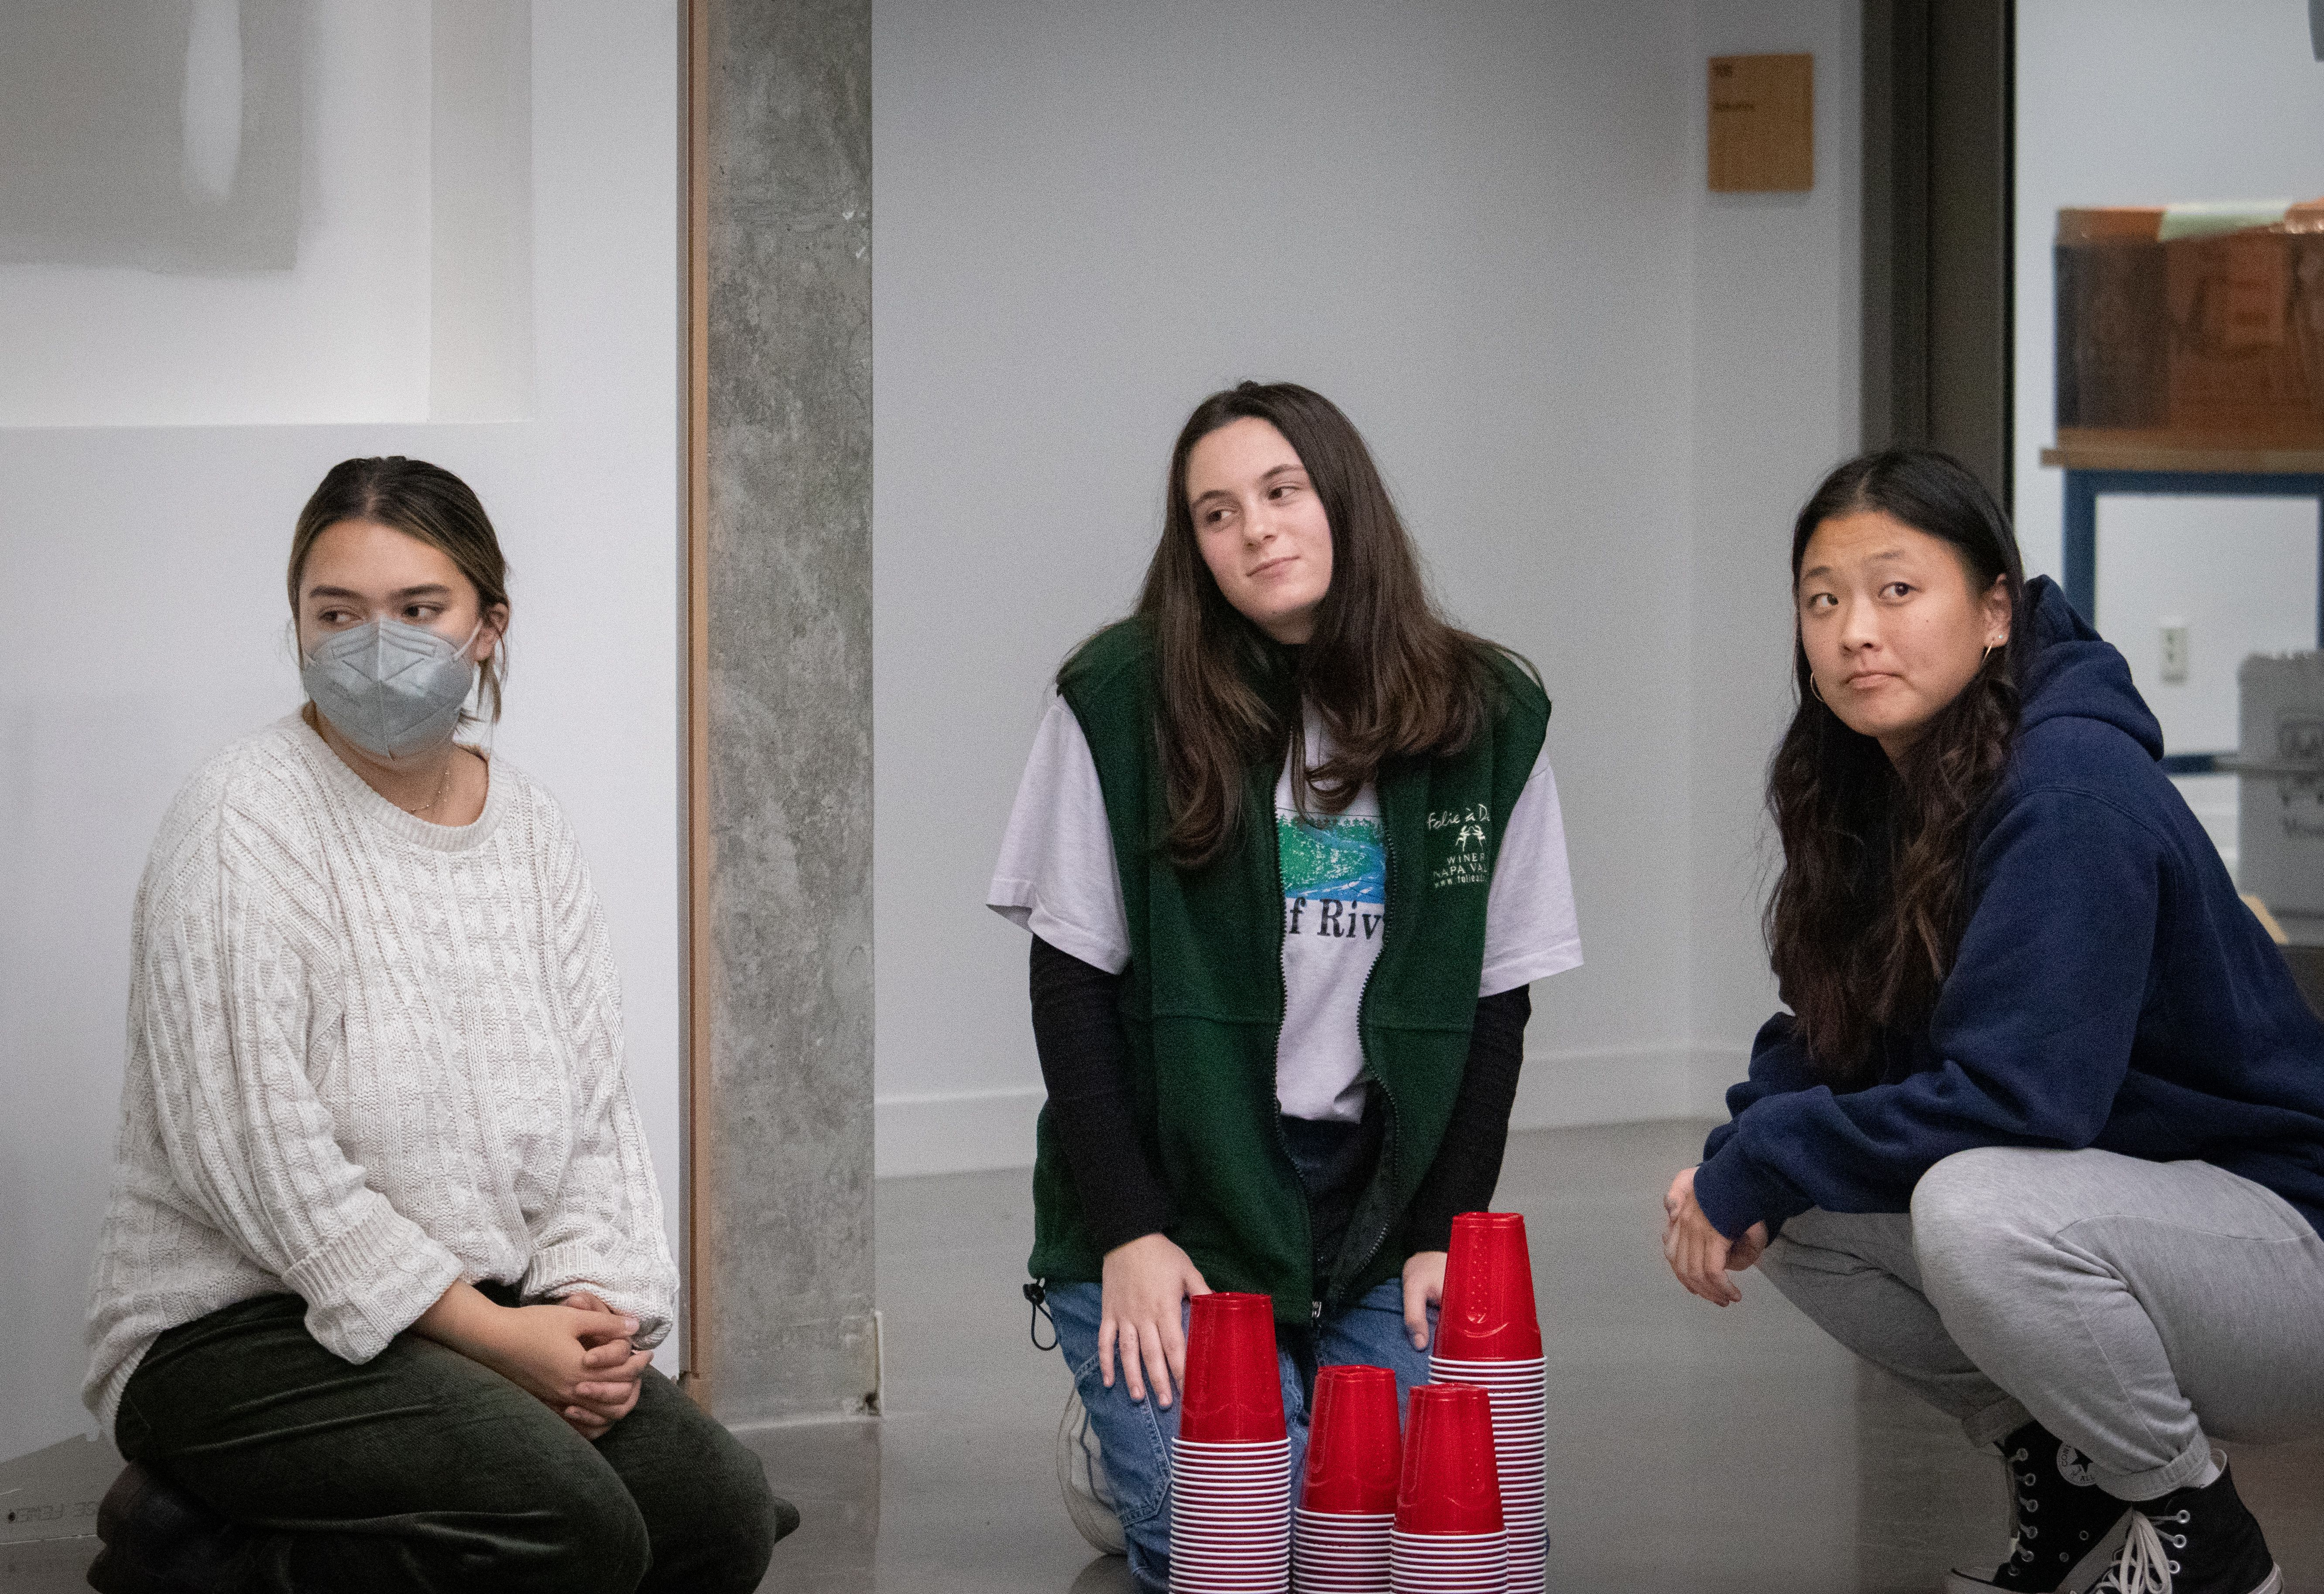
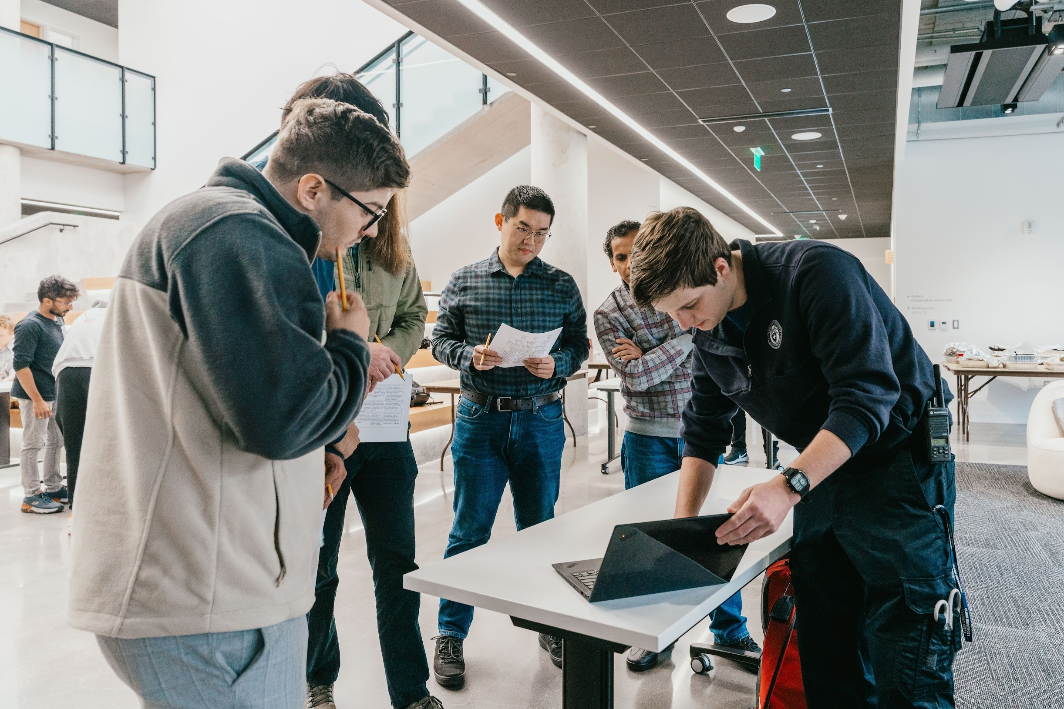
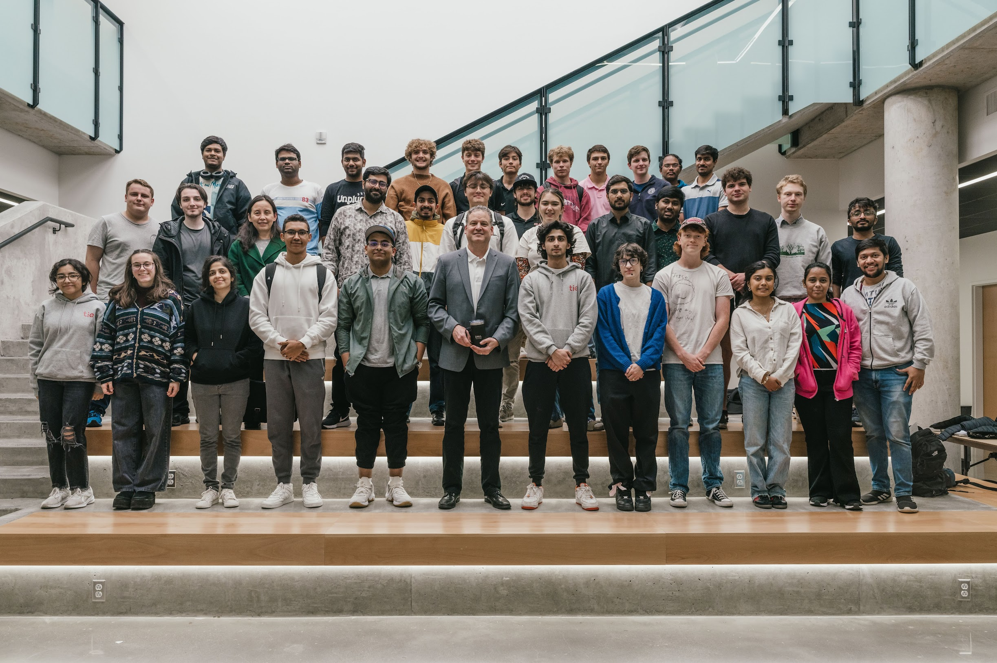
Photos by Natalie and Danny

Slide 2


Slide 3

THEME Sustainability & Green Initiatives

Slide 4
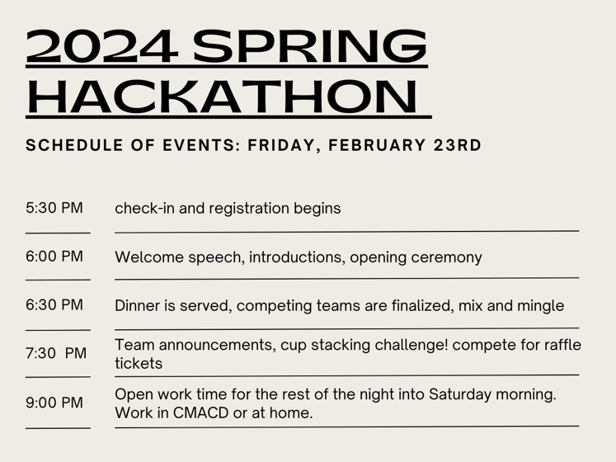
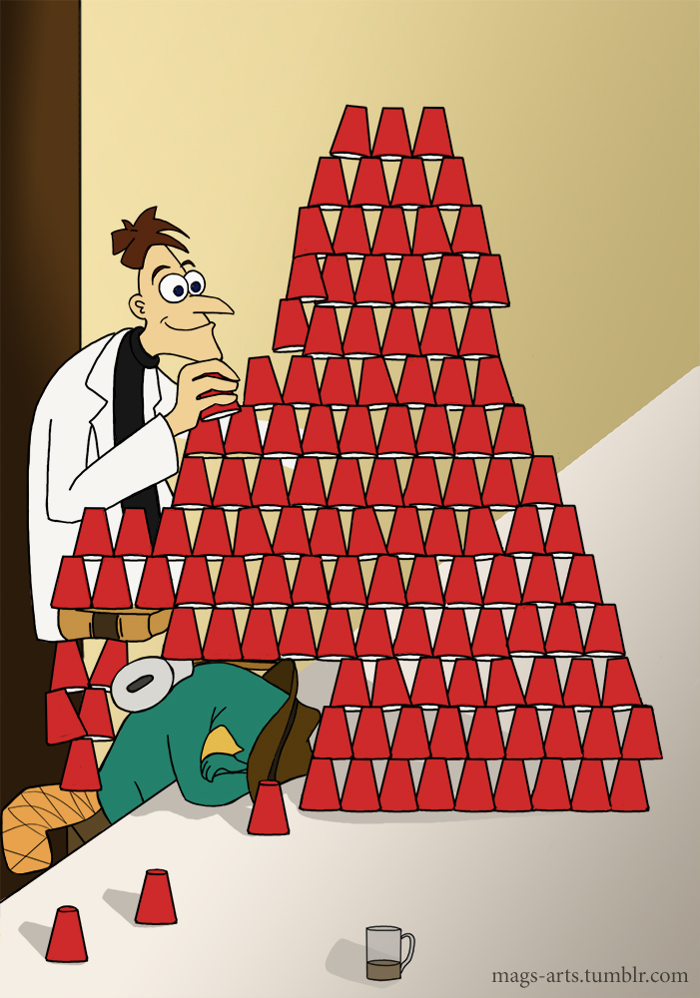


Slide 5

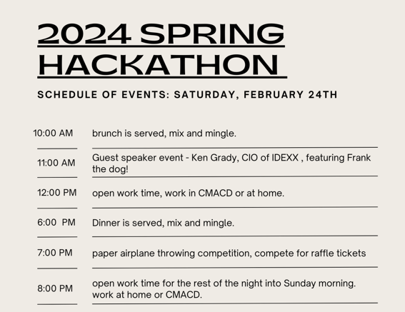
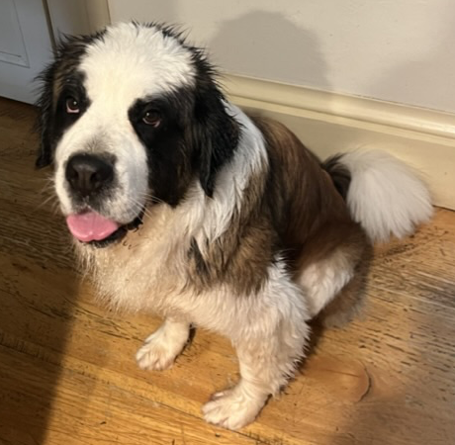

Slide 6

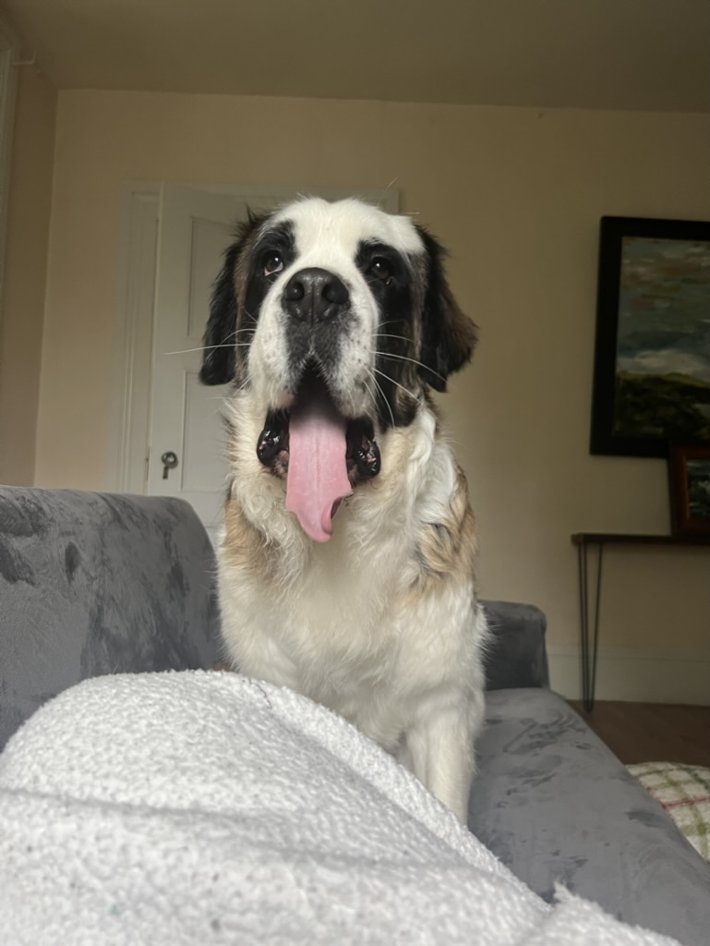

Slide 7

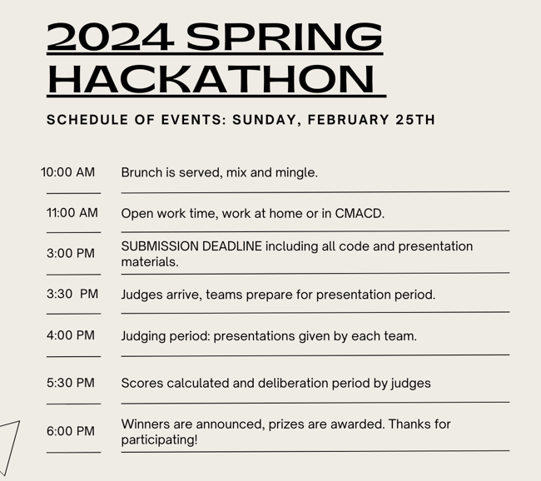


Slide 8
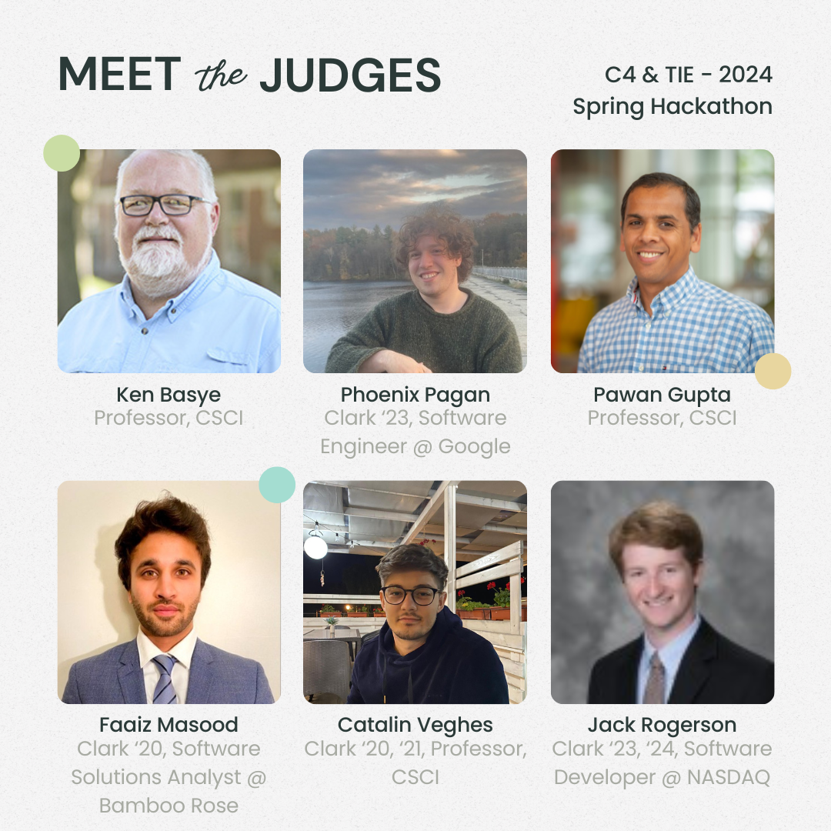
Judging
Judging will be on Sunday @ 4pm
Each group will present to our judges and the C4 & TIE E-Boards

Slide 9


IMPORTANT THINGS TO KNOW
RAFFLE TICKETS FOR ATTENDING SPEAKER & MORALE EVENTS
HELP OPPORTUNITIES FROM C4/TIE EBOARD IN LOBBY

Slide 10

COMMUNICATION
Join the Teams channel for updates throughout the weekend!

Slide 11
Next up…
Head up to CMACD lobby for dinner and the cup stacking challenge with your team!
If you're still looking for teammates, come talk to us!

